Slide 1
Synchrophasors Magnitude and Phase Steps
Marcelo Britto Martins

Slide 2
Sampling issues – Generation and Sampling @ 4800Hz
Estimation with Steady State Fit
Phase and frequency unstable
Phase drift -4.5 degrees/s

Slide 3
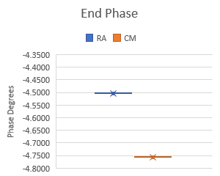
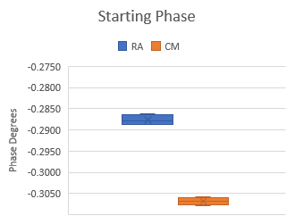
Sampling issues – Generation @ 14400Hz, Sampling @ 4800Hz – (RA vs CM)
Starting phase more stable
Phase drifts linearly -4.5 to -4.75 degrees/s
Frequency low, variation ~ 0.02 Hz

Slide 4
Sampling issues – Generation @ 14400Hz, Sampling @ 4800Hz – (RA vs CM)
Using CM would sync the generation with sampling
There should not be significant phase or frequency errors and variation

Slide 5
Sampling issues – Generation @ 14400Hz, Sampling @ 4800Hz
Generator was taking 4799 or 14399 samples/s - fixed that
Phase drift of 3.3 degrees/s

Slide 6
Sampling issues – Generation @ 48000Hz, Sampling @ 5000Hz
Taking a better generator -> 48000Hz
DVM truncates at 100ns (1/10MHz)
(dt = 1/4800 = 0.028033 s)
Changing dt in the analysis -> phase drift of 3deg/s
Change the sampling frequency to 5000Hz -> dt = 0.02s
Generator 10MHz clock from:
Atomic clock: phase drift of 0.3 deg/s
Multimeter clock:
phase stable, with variations in the order of 0.001 deg (variando na Terceira casa?)
Frequency stable, with variations in the order of 0.0001 Hz (variando na quarta casa?)
Best configuration:
1 PPS trigger from atomic clock (UTC) for both
Generation at 48000Hz, 10MHz clock from DVM
DVM at 5000Hz, internal 10MHz clock

Slide 7
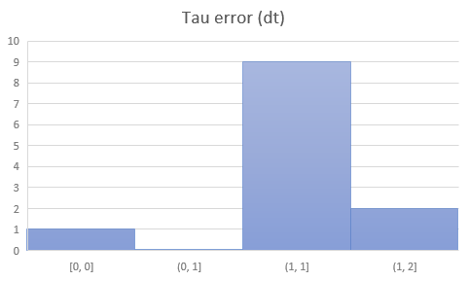
Hilbert filter
Estimation of tau for all tests
Simulation vs real data ?
Max error: 2dt
Min error: -1dt

Slide 8
Phase step - example
Tau = 0.2T, 10deg step
5th window

Slide 9
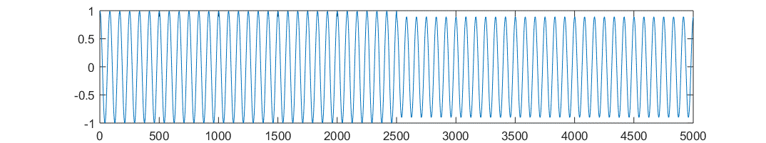
1
2
3
4
5
6
7
8
9
Samples

Slide 11
Phase Steps: Frequency (SS fit vs LM)
LM is more stable and accurate for different step instants (tau)
Uncertainty?
What about other phases?

Slide 12
Phase Steps: Frequency (SS fit vs LM)
Frequency:
Steady State:
0.0001 Hz variation
Steps:
SS_fit: 0.5Hz error
LM_fit: 0.05Hz error
LM more stable and accurate during phase step

Slide 13
Phase Steps: Magnitude (SS fit vs LM)
LM is more stable and accurate

Slide 14
Phase Steps: Phase (SS fit vs LM)
SS and LM have
Good results

Slide 15
Magnitude Step: Frequency
Frequency estimation in function of step instant
To do:
Compare with simulations
Preliminary results indicate that
LM is more reliable during steps
If so, the generator frequency is not stable during mag step

Slide 16
Magnitude Step: Magnitude
In fact, magnitude and phase of a synchrophasor are always related to the nominal frequency.
If the estimated frequency deviates from the nominal, their estimation is affected.

Slide 17
Magnitude Step: Phase

Slide 18
Magnitude Step: Phase

Slide 19
Questoes
Variacao de fase com a frequencia nominal: efeito do estimador?
Nao, esta variacao e esperada, pois para o sincrofasor a fase varia quando a frequencia varia. O que esta variando realmente e a frequencia!
Quais as variações considerando as incertezas?

